Slide 2
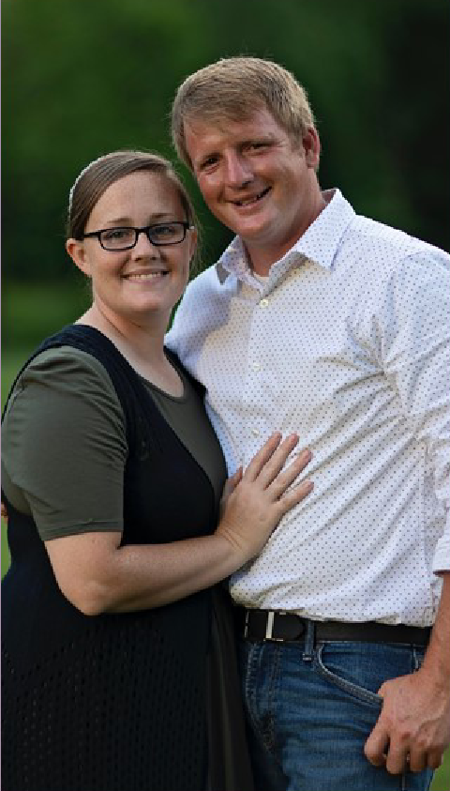
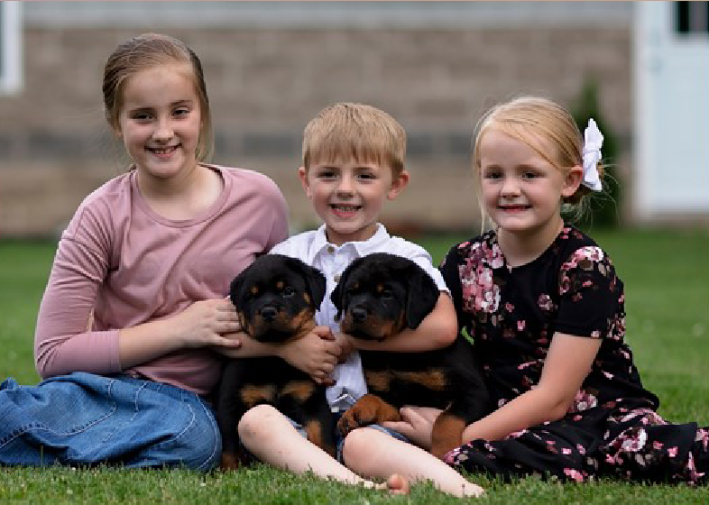
David and Michelle Weaver
Diamond Founder 2.0

Slide 3
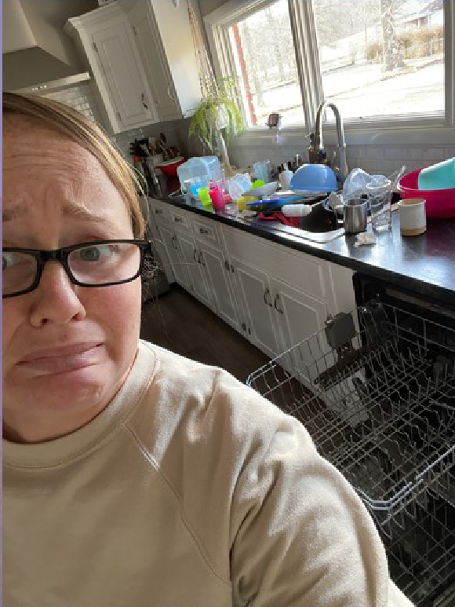
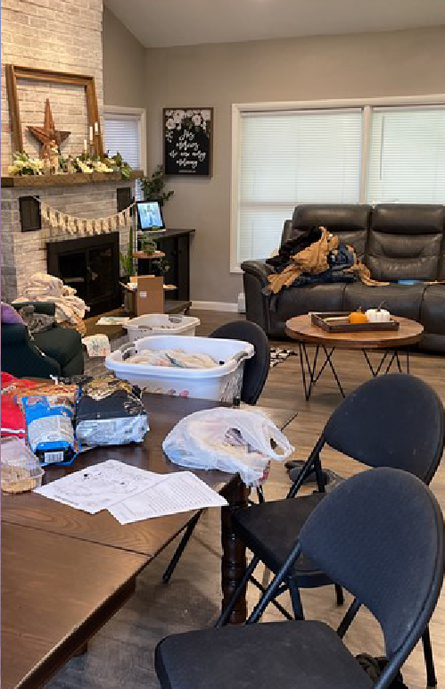
Busy Mum! Busy Life!

Slide 4
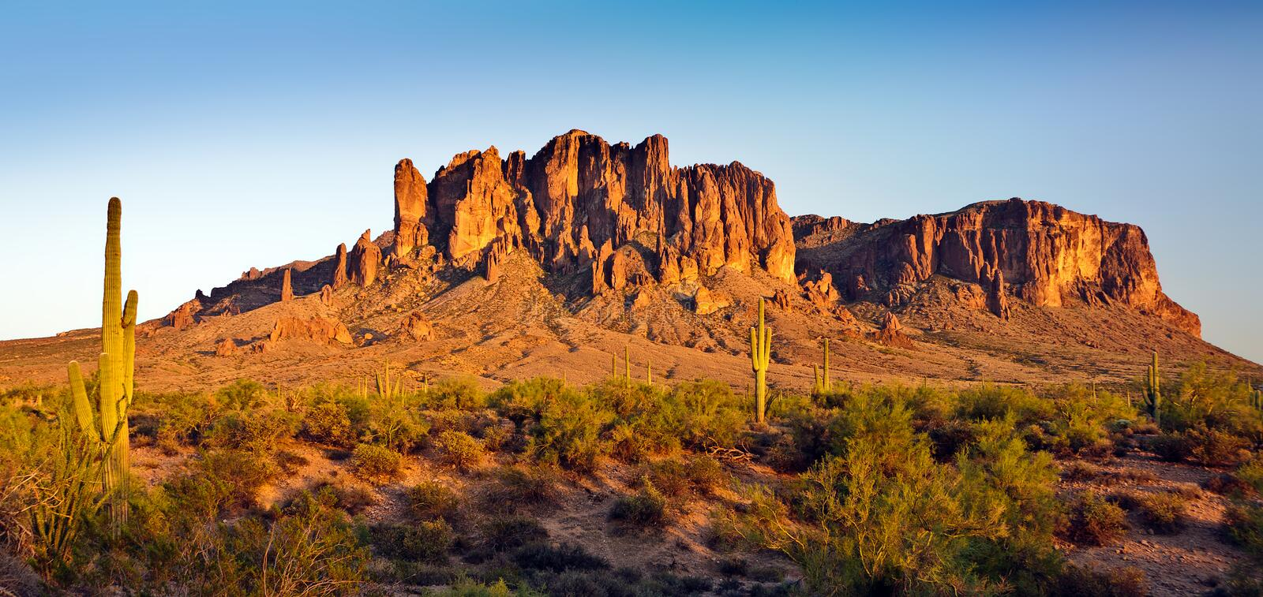
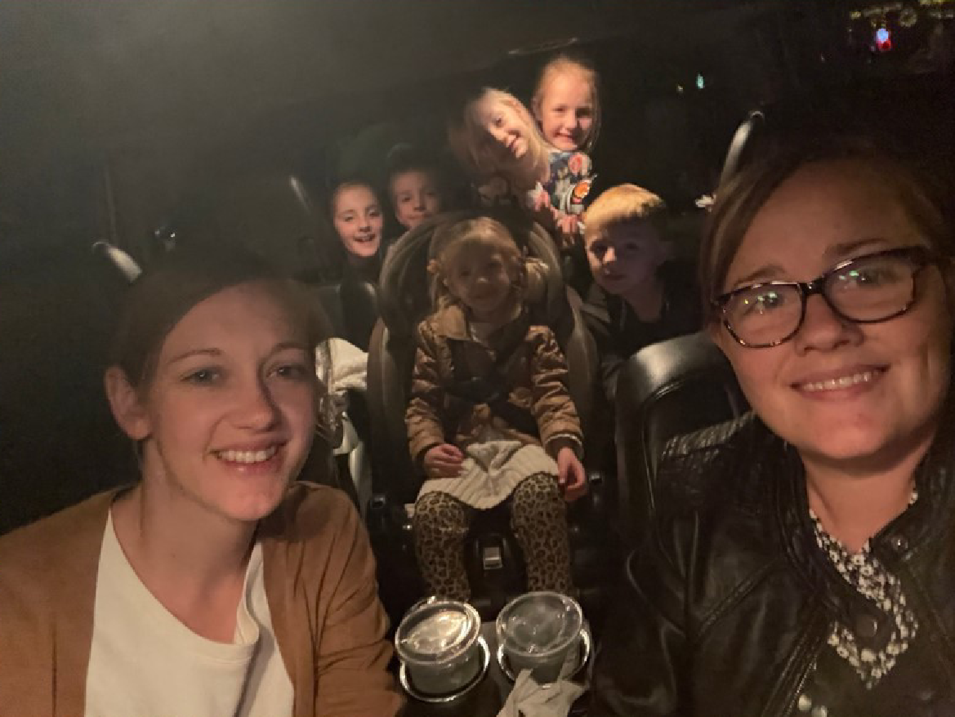
Busy Mum
Lots of kids.
Mum’s taxi service

Slide 5
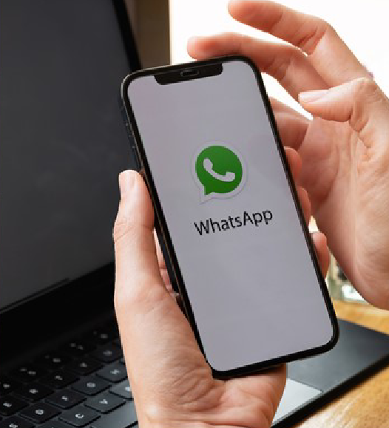
A Fresh Look At
ONLINE CLASSES

Slide 6
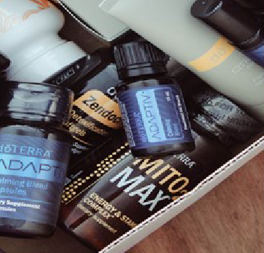
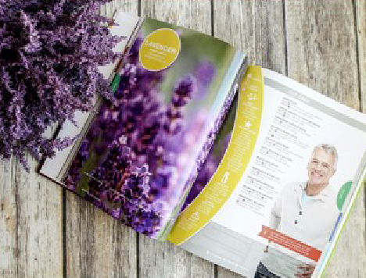
What You Need
To teach a successful class
Your Products Your Phone Oil Guidebook

Slide 7
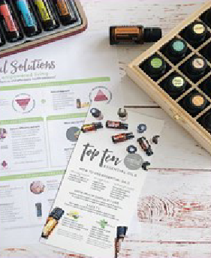
Find A Hostess
Good morning! I was just thinking of you! I was curious if you were interested in hosting an online dōTERRA party. This would be such a fun opportunity for your friends and family!
And as a thank you for hosting the party, I always give an oil reference guidebook for every single host when you have 5 new customers in your party. In addition to that, you'll have the opportunity to earn some free products!
Would May 16th or May 21st work best for you?
Set The Date
Be Your Own Hostess
Invite Current Customers
Invite Prospects
Invite Builders to Join and Invite
Hostess Incentives
Free Guidebook
Free products
Sample Keychain (Fill samples if 3 enroll)

Slide 8
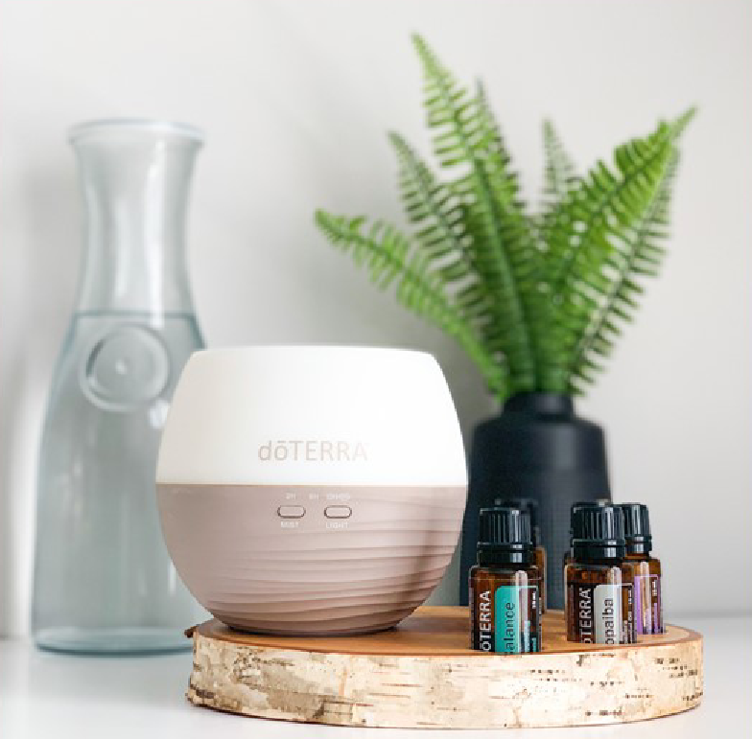
Create The Group
2 - 3 days before the class
Create Group
Add a Profile Photo
Add the Hostess

Slide 9
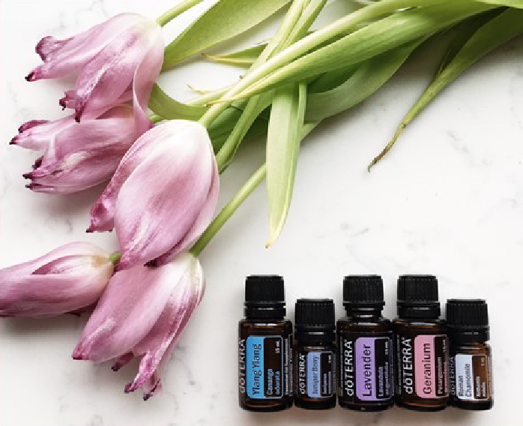
Invite Attendees From The Hostess
Share a script with your hostess
Show them how to copy and paste.
DO NOT FORWARD!!!
Hi ......! How are you?
I am so excited to be hosting an online dōTERRA class this next week! We will be learning how to use essential oils, why I love dōTERRA, and a bunch of fun recipes! The party starts on Monday morning and ends on Wednesday.
I think you would love it and I didn't want to leave you out!
Would you like the link to join the class?

Slide 10
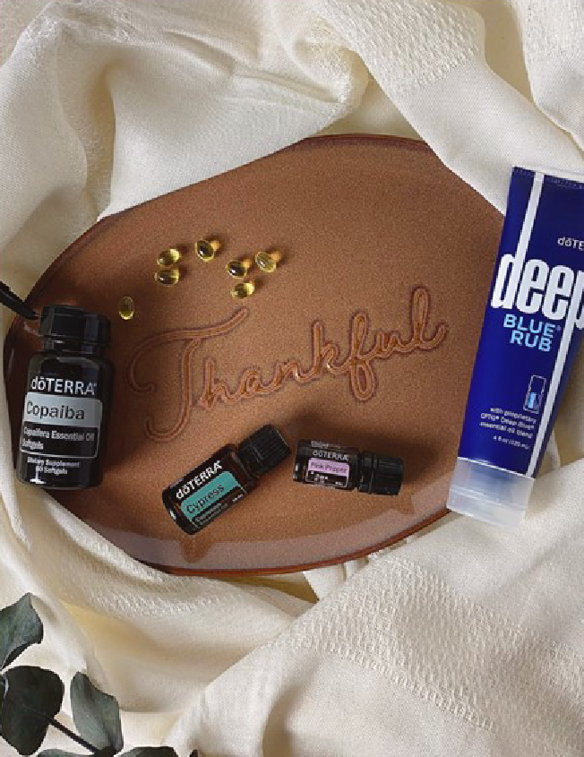
Welcome Message
For the new invitee
Good morning!
I wanted to personally say hi and thanks for joining Monica's dōTERRA party! I'm so happy to have you join in and learn.
If you have any questions, please do ask in the group or feel free to message me at any time!
YOU CANNOT SKIP THIS

Slide 11
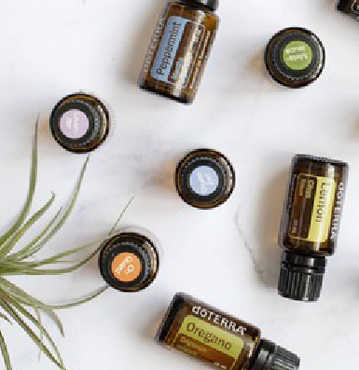
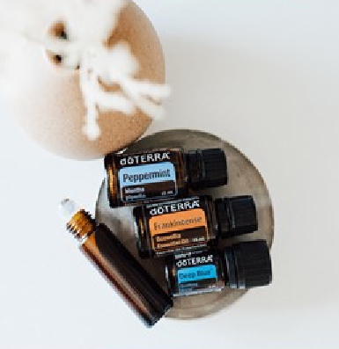
Daily Posts In Your Group
Interactive Post Class Time Fun Reminder
Introductions
Share a favourite vacation spot
Post a health concern they hope we address this week
Short videos (5-7 min)
Graphics/recipes
Repeat
Keep posts a few minutes apart
Keep posting time under 40 minutes
Keep it simple
Keep it educational
Use as a "reminder" to watch videos

Slide 12
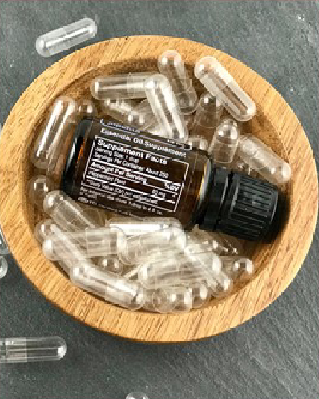
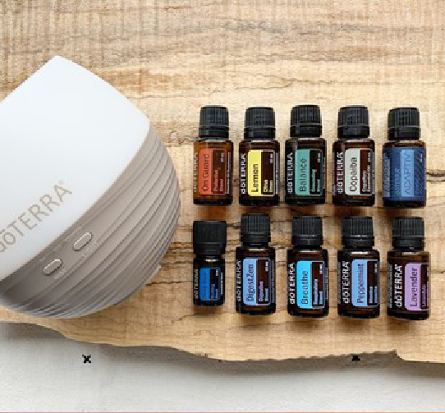
DAY 1
What are Essential Oils. Why dōTERRA? Top 10 Oils.
K E E P I T S I M P L E

Slide 13
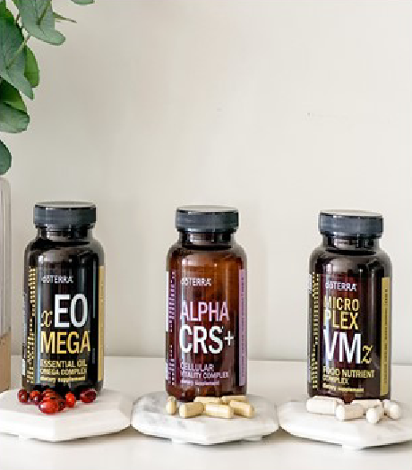
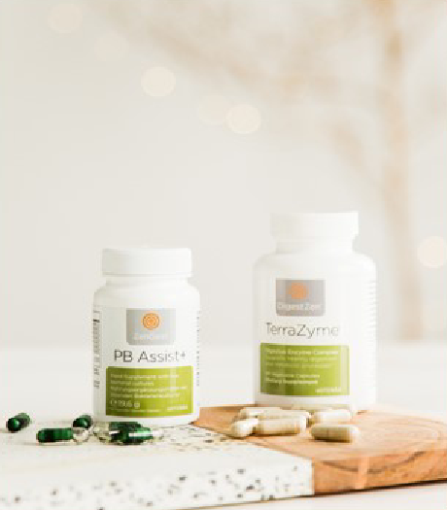
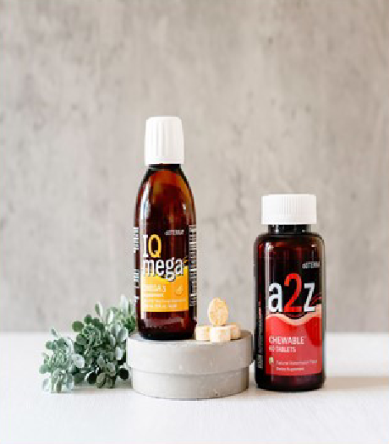
Day 2
Supplement Day

Slide 14
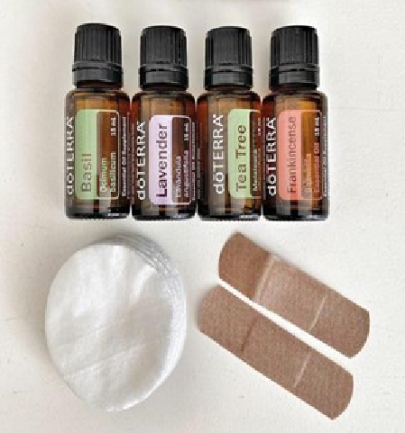
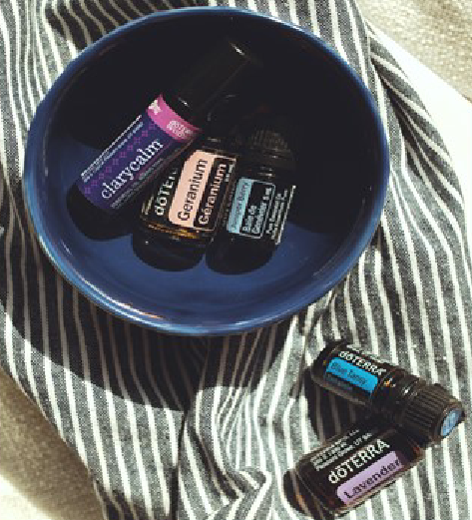
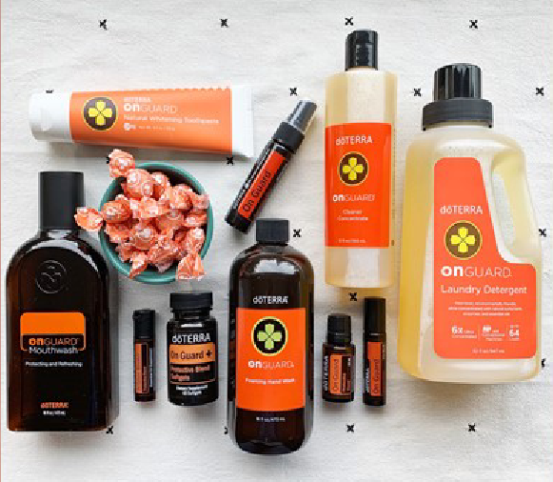
Day 3
Continued Education and Close

Slide 15
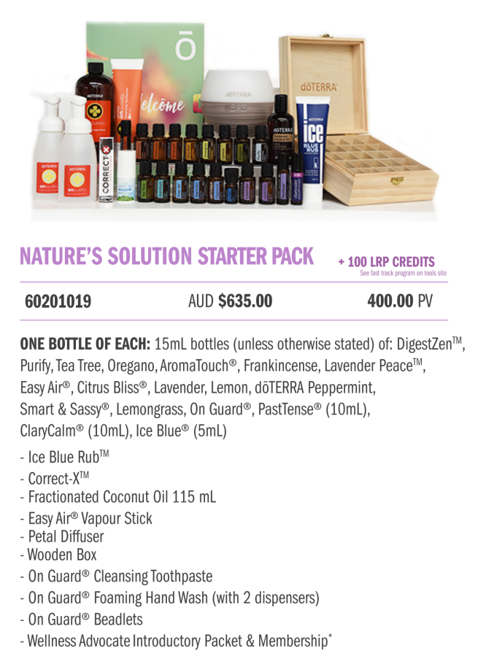
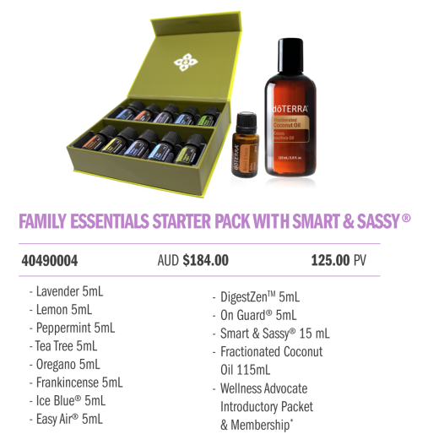
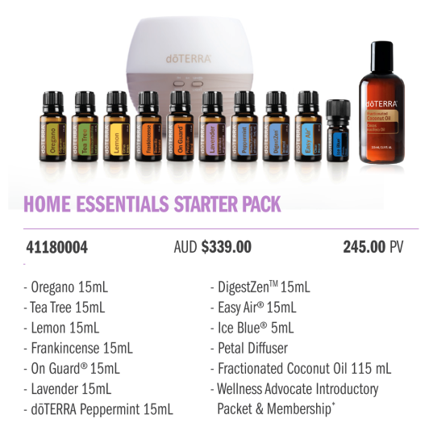
The Close
Post each collection along with the description of what is included.
Nature's Solution Kit is very popular as it contains something for every area in the home.
The Essentials Starter Kits. They are the favourite and popular kits. You will receive the top 10 oils (in 5ml bottles or 15ml bottles) we chatted about on day 1 of this class, as well as a free 15ml Smart and Sassy (or diffuser) and Fractionated Coconut Oil.
The Home Essentials Kit is 3 times the size, but not double the price.

Slide 16
Grand Prize
Includes 2 giveaways
Oil guide book for hostess
Oil grab bag for new customers
DIY items (rollers, sprayers, label and pouch)
They must place a 100pv order to enter giveaway

Slide 17
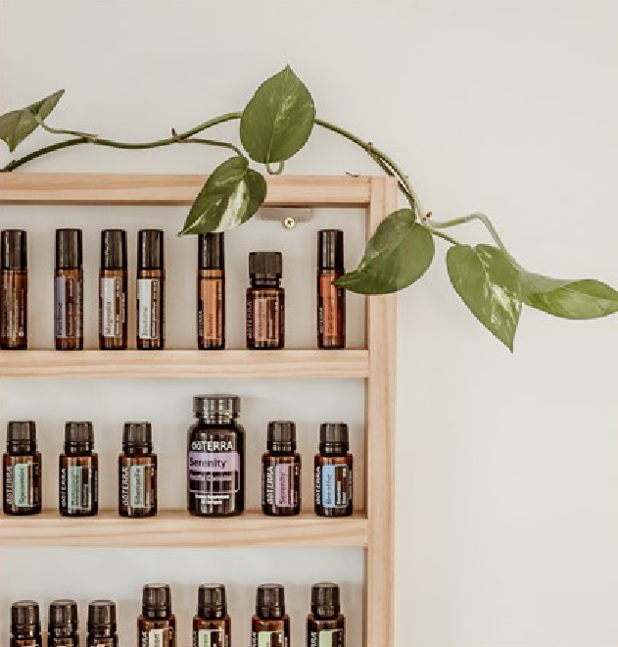
The Bonus!
Thank you to everyone for joining us on this dōTERRA party! I have enjoyed sharing with you some of the products and oils that we have with dōTERRA!
Before we officially end this class, I wanted to share a bonus giveaway!
The first 5 who grab their starter kit will win a free mystery oil in their pack from me!
First come, first served! Who's name is on the list?
1.
2.
3.
4.
5.

Slide 18
The Secret Sauce
F o l l o w u p
Message every single person.
Thank them for joining
Remind them of the giveaway
Offer to answer questions

Slide 19
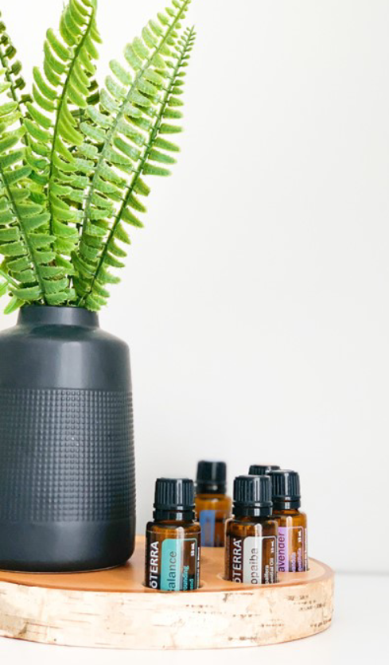
Bonus Tips
Normal B+ Work
Show up and serve
It doesn't need to be perfect
B+ work give better results than never showing up. It shows that anyone can do this
Where You Need A+ Work
Customer service and serving from the heart
Consistently showing up
Keeping it simple and duplicatable
Make This Class Yours
Teach what you know
Teach what your customers want to hear
Keep it simple, stick to the basics

Slide 20
Don’t Quit Before The Miracles Happen
And Only Quit On A Good Day

