Slide 1
Realistic Expectations
Building your dōTERRA business

Slide 2

Hitting goals in 2018
What can you expect?

Slide 3

Where do you want to be in 2018?
The ranks are stepping stones!

Slide 4


How this business is like losing weight!
It’s daily choices (sometimes hour by hour choices)
It’s long term (lifestyle change)
Quick diet gimmicks can lead to short term results that don’t last!!
It takes time to have long term results!
It is all based on YOUR effort!!

Slide 5
What expectations may people have:
I can do this business 1-2 days a month and make $1000 a month!
My upline must put people under me!
Little, halfhearted effort should equal results!
I should hit diamond in six months with my 2-5 hours a week of investing in my business!
I can pick up and put down my business whenever I want and when I pick it up all the momentum should stay in place.

Slide 6
“I can eat whatever I want and will lose weight!”
“I will eat good 1-2 days a month and still lose 10 pounds!”
“My coach better make me lose 5 pounds!”
“I should hit 30 pounds loss in 6 months with the very little effort I am putting in!”
“I can make bad choices and still be seeing weekly weight loss!”
–Weight-loss Wannabe

Slide 7

Facts:
dōTERRA is a business!
Finding success requires consistent effort..daily activities!
Finding success requires 3-10 hours a week for up to 2 years to see lasting results!
The products work, the comp plan works…the variable factor is: YOUR effort!!

Slide 8
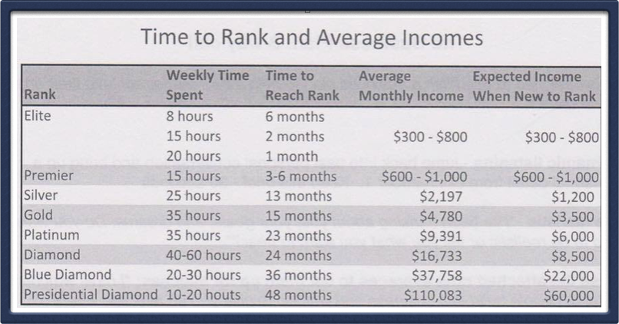
Real Expectations
Look at rank goal for 2018…what time do you need to give your business?

Slide 9

There will be obstacles!!
You have to make the decision to overcome and quit!

Slide 10
Think of Oil Builders as your Weight Watchers meeting!! (p.s. this is meant to be a joke!)
Cheer you on!
Support you!
Recognize your success!
Love on you!
“Lose weight” with you!
Keep you accountable

