Slide 1
Empowered University
Six Training Sessions to Launch YOUR Business
Session Five

Slide 2
Casting a Vision & Practical Steps to Reaching your Goals

Slide 3
Why have a vision?
Know where you are going
Help to see growth
To have measurable activities
Helps set goals

Slide 4
Examples of Goals
Host two classes next month
Hit Elite
Work on power of 3 $50 bonus
Schedule 2 membership overviews next week
Work on dōTERRA an hour a day
Share dōTERRA with 2 new people a week

Slide 5
Make your goals
personal and obtainable!
Keep them simple!

Slide 6
Make Goals around PIPES
Prepare
Invite
Present
Enroll
Support
Page 3-4 of Launch Guide

Slide 7
Be Accountable!
Tell your mentor/coach your goals & write them down!

Slide 8
Treat it like a business and it will pay you like a business!

Slide 9
You can do this business full time
You can do this business part time
But you can’t do it sometime!
Justin Harrison

Slide 10
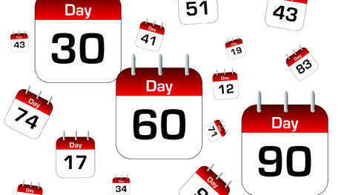
Set Goals Monthly
30 day goals
60 day goals
90 day goals

Slide 11
Vision/Dream Board
Have a vision of where you want to go and make it tangible!
Think about what dreams you have if time and money were no object.
What are your dreams and how can dōTERRA help those become a reality?

Slide 12
Practical Steps to achieve goals

Slide 13
Plan Weekly Power Hour
Who needs a sample?
Who needs an invitation to a class/appointment?
Who needs to enroll?
Who needs a Live Guide Overview?
Who needs an invitation to learn more about the business?

Slide 14
On the 15th of the month you should…
Have checked on your bonus
Schedule next month classes
Have all Lifestyle Overview’s schedules from last months enrollments
You’ve placed your order for at least 125 PV
Work on 30, 60, 90 day goals

Slide 15
End of the month checklist
Check Power of three
Check Rank
Write down final numbers (OV, team members, new members)
Update Names list

Slide 16
Beginning of the Month
Check in with users to make sure they know about special
Understand all promotions (Read all FAQ of promotions)
Are all Live Guides scheduled with new customers
Make sure all hosts are prepared and ready for classes

Slide 17
Back Office
You need to know your numbers (OV/PV, Power of 3)
You should check back office at least 3 times a week
You need to check back office to see where your qualifiers are in their OV

Slide 18
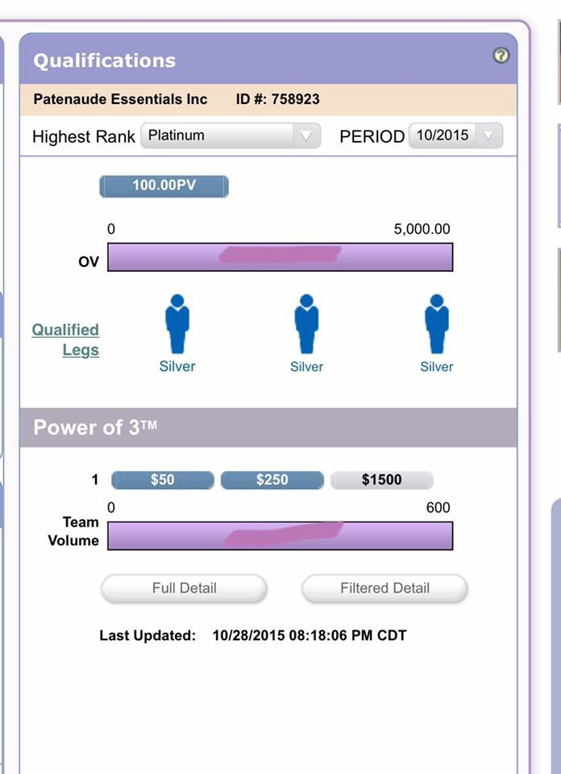
Dashboard Tab
What to check?
This shows you right where you are with rank and power of three.
You can go back two or three months with “Period” menu

Slide 19
Graphic Tree
What to check?
Who has LRP
What rank they are

Slide 20
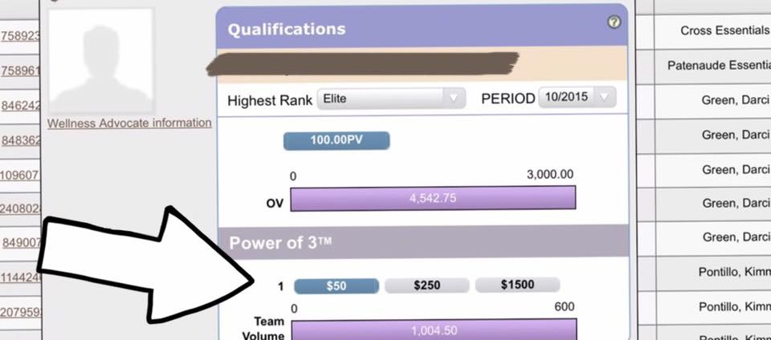
Detailed Genealogy
What to check?
You can see someones rank
Their power of three
Team Volume for power of three

Slide 21
Homework
Write 30, 60, and 90 day goals
Watch the video on how to use your back office
Create a vision board and hang where you see it
Watch video on Power Hour
Watch Kirk Hamilton video on creating a vision board
Check bonus, schedule classes for next month, schedule Lifestyle Overviews with last month enrollments, place order, write goals, & team mapping

